Slide 1
Introduction & Background Module 1
Operating Systems
Nadia Qureshi

Slide 2
Evolution of Operating Systems

Slide 3
Evolution of Operating Systems
Offline input devices like cards or paper tape reader were introduced later
A program loader was established in Computer memory to read program from input device and setup it in memory
New input/output technologies were applied to assist in improving system performance
Notes:
What is an offline input device
A device which is not connected to CPU.

Slide 4
Evolution of Operating Systems
Around 1960, a new computer called Atlas was developed with the requirements of an operating system in mind
Batch processing was applied to submit jobs in batches to the computer
Multiprogramming was introduced to run several programs at the same time
The processor should be kept busy for most of the time by switching its attention from one program to another
Notes:
Punch card
Paper Tape
Magnetic Tape
No PC at that time so these tapes were given to the operator
Then similar tasks were made a batch and the problem was solved but till then CPU sits Idles which was a drawback

Slide 5
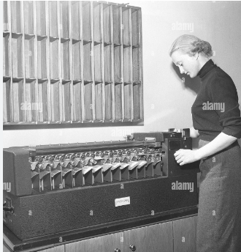
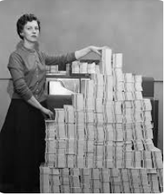
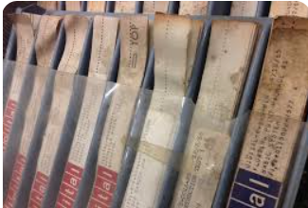
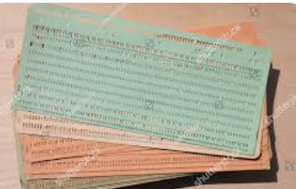
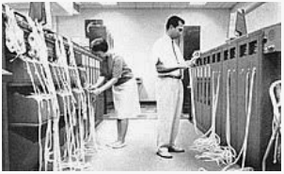
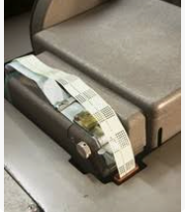
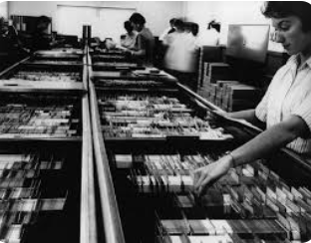
Punched Cards and Paper Tapes from the Past

Slide 6
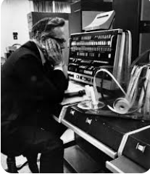
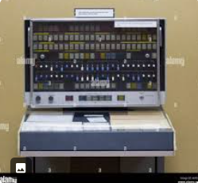
1960’s Atlas

Slide 7
History of OS
https://www.youtube.com/watch?v=e-YI-fjI8Nc
Watch the video

Slide 8
Evolution of Operating Systems
First Time sharing system (support multiple interactive users) was developed at MIT
Mini Computer took place having multi-user OS
Spooling (Simultaneous Peripheral Operation On-line) technique was introduced
it is used to absorb surplus processor time by performing I/O transfers for other jobs

Slide 9
Assignment 1: details about the following concepts
Batch Processing
Time sharing
Spooling
Multi programming
Multi processing
Handwritten assignments: make PDF using cam scanner and upload it on Moellim
Deadline: 4 March 2025 ( Quiz1 from the same content on 4 march)

Slide 10
Types of Operating Systems

Slide 11
Types of Operating Systems
With the passage of time operating systems are divided into different categories. They can be categories as follows
Single User OS
Distributed OS
Network OS
Multiprocessor OS
Real-time OS
Embedded OS

Slide 12
Single User Operating Systems
These types of OS were commonly used with computer systems referred as Personal Computers in 1980s, 1990s and early 2000s
Cheaper OS
Easy to use
May run several different types of operating systems (Windows, MacOS, UNIX, Linux)
Supports multiple applications
not dedicated for one type of application
Have centralized resources
Supports multimedia (images, text, graphics and audio/video)
Example:
Windows 98,ME
Linux

Slide 13
Network Operating Systems
Network Operating Systems are used to connect more than one computer
User can login to a remote computer, to share its resources
Network OS does not follow any transparency (e.g. location, migration)
Every operation has to be explicitly specified by the user
User knows where his job is processing
Examples:
Windows NT
Sun Solaris
Notes:
Network transparency, in its most general sense, refers to the ability of a protocol to transmit data over the network in a manner which is not observable (“transparent” as in invisible) to those using the applications that are using the protocol.

Slide 14
Distributed Operating Systems
Distribute computation among several physical processors
Follows the transparencies
Requires networking infrastructure
Local area networks (LAN) or Wide area networks (WAN)
May be either client-server or peer-to-peer systems
Main features of Distributed System
Resource sharing
Computation speed up
Reliability
Communication
Notes:
What is distributed system explain?
A distributed system is a computing environment in which various components are spread across multiple computers (or other computing devices) on a network. These devices split up the work, coordinating their efforts to complete the job more efficiently than if a single device had been responsible for the task.

Slide 15
Distributed Operating Systems
Two types of Distributed OS
Tightly coupled DOS
Multiprocessor system
Processor share memory
Communication takes place through memory
Highly collaborative
Loosely coupled DOS
Clusters of workstations
Do not communicate via memory
Communicate via high speed buses, telephone lines
Communicate over the network
Tightly coupled systems share a single memory space and share information through the shared common memory. Loosely coupled multiprocessors consist of distributed memory where each processor has its own memory and IO channels. The processors communicate with each other via message passing or interconnection switching.
Examples:
Windows 2000
Linux
Unix
Notes:
Tightly coupled systems share a single memory space and share information through the shared common memory. Loosely coupled multiprocessors consist of distributed memory where each processor has its own memory and IO channels. The processors communicate with each other via message passing or interconnection switching.

Slide 16
Multiprocessor Operating Systems
These are actually distributed operating systems which run on machines having more than one processor
Communication is done via shared memory through message passing, pipes etc.
used to boost the performance of multiple CPUs
Multiple CPUs are linked together so that a job can be divided and executed more quickly.
Unix
Linux
Solaris
Notes:
Multiprocessor operating systems are used to boost the performance of multiple CPUs within a single computer system. Multiple CPUs are linked together so that a job can be divided and executed more quickly. When a job is completed, the results from all CPUs are compiled to provide the final output.

Slide 17
Real-time Operating Systems
These OS run on Real-time systems
Very fast operating system
Normally designed for a set of specific applications
A real-time system is any information processing system which has to respond to externally generated input stimuli within a finite and specified period
the correctness depends not only on the logical result but also the time it was delivered
failure to respond is as bad as the wrong response
In a real time system emphasis is on timely execution of tasks than speed of execution
Often used as a control device in a dedicated application such as controlling scientific experiments, medical imaging systems, industrial control systems, and some display systems
Real-Time systems may be either hard or soft real-time
Notes:
Real time immediate response for example youtube streaming
Time delay nahy hota

Slide 18
Real-time Operating Systems
Hard real-time system
systems where it is absolutely imperative that responses occur within the required deadline
E.g. Flight control systems, air bag system, industrial/nuclear systems
Secondary storage limited or absent, data stored in short term memory, or read-only memory (ROM)
Soft real-time system
systems where deadlines are important but which will still function correctly if deadlines are occasionally missed
E.g. Data acquisition system, transaction systems, online streaming etc
Limited utility in industrial control of robotics
Useful in applications (multimedia, virtual reality) requiring advanced operating-system features

Slide 19
Embedded Operating Systems
These operating systems are dedicated for devices
These are normally built-in with devices
Example:
Mobile set OS
PDA OS
Issues:
Limited memory
Slow processors
Small display screens
Notes:
Example Microwave Machine AC

Slide 20
Computing Environments

Slide 21
Computing Environments - Traditional
Stand-alone general purpose machines
But blurred as most systems interconnect with others (i.e. the Internet)
Portals provide web access to internal systems
Network computers (thin clients) are like Web terminals
Mobile computers interconnect via wireless networks
Networking becoming ubiquitous – even home systems use firewalls to protect home computers from Internet attacks

Slide 22
Computing Environments - Mobile
Handheld smartphones, tablets, etc
What is the functional difference between them and a “traditional” laptop?
Extra feature – more OS features (GPS, gyroscope)
Allows new types of apps like augmented reality
Use IEEE 802.11 wireless, or cellular data networks for connectivity
Leaders are Apple iOS and Google Android
Notes:
Gyroscope used in locaton and positioning, used in compasses.

Slide 23
Computing Environments – Distributed
Distributed
Collection of separate, possibly heterogeneous, systems networked together
Network is a communications path, TCP/IP most common
Local Area Network (LAN)
Wide Area Network (WAN)
Metropolitan Area Network (MAN)
Personal Area Network (PAN)
Network Operating System provides features between systems across network
Communication scheme allows systems to exchange messages
Illusion of a single system

Slide 24
Computing Environments – Client-Server
Client-Server Computing
Dumb terminals supplanted by smart PCs
Many systems now servers, responding to requests generated by clients
Compute-server system provides an interface to client to request services (i.e., database)
File-server system provides interface for clients to store and retrieve files
Example : Gmail

Slide 25
Thin Vs Fat/Thick Clients
The difference between the two is that thin clients rely on a network connection for computing and don't do much processing on the hardware itself. Thick clients don't need the constant network connection and can do much of the processing for client/server applications.
Web browsers are examples of thin client
Thick clients not necessarily rely on distributed network for its working, It is capable of doing its processing locally, it has some resources.
Video games, MS office

Slide 26
Computing Environments – Peer-to-Peer
Another model of distributed system
P2P does not distinguish clients and servers
Instead all nodes are considered peers
May each act as client, server or both
Node must join P2P network
Registers its service with central lookup service on network, or
Broadcast request for service and respond to requests for service via discovery protocol
Examples include Napster and Gnutella, Voice over IP (VoIP) such as Skype
Example: WhatsApp, Skype

Slide 27
Computing Environments - Virtualization
It treats hardware and the operating system kernel as though they were all hardware
A virtual machine provides an interface identical to the underlying bare hardware
The operating system creates the illusion of multiple processes, each executing on its own processor with its own (virtual) memory
The resources of the physical computer are shared to create the virtual machines
CPU scheduling can create the appearance that users have their own processor
Spooling and a file system can provide virtual card readers and virtual line printers

Slide 28
Computing Environments - Virtualization
Allows operating systems to run applications within other OSes
Vast and growing industry
Emulation - the use of one computer system to imitate the functionality of another
Generally slowest method
emulation could allow a Windows OS to be run on a Mac computer
Virtualization – the use of software to create an abstraction layer on top of computing resources for the purposes of partitioning and sharing those resources
Consider VMware running WinXP guests, each running applications, all on native WinXP host OS
VMM provides virtualization services
For further details visit the site on the link:
https://blog.purestorage.com/purely-educational/emulation-vs-virtualization/

Slide 29
Computing Environments - Virtualization
Use cases involve laptops and desktops running multiple OSes for exploration or compatibility
Apple laptop running Mac OS X host, Windows as a guest
Developing apps for multiple OSes without having multiple systems
QA testing applications without having multiple systems
Executing and managing compute environments within data centers
VMM can run natively, in which case they are also the host
There is no general purpose host then (VMware ESX and Citrix XenServer)

Slide 30
Computing Environments - Virtualization

Slide 31
Computing Environments – Cloud Computing
Delivers computing, storage, even apps as a service across a network
Logical extension of virtualization as based on virtualization
Amazon EC2 has thousands of servers, millions of VMs, PBs of storage available across the Internet, pay based on usage
Deployment Types
Public cloud – available via Internet to anyone willing to pay
Private cloud – run by a company for the company’s own use
Hybrid cloud – includes both public and private cloud components
Service Types
Software as a Service (SaaS) – one or more applications available via the Internet (i.e. word processor)
Platform as a Service (PaaS) – software stack ready for application use via the Internet (i.e a database server)
Infrastructure as a Service (IaaS) – servers or storage available over Internet (i.e. storage available for backup use)

Slide 32
Computing Environments – Cloud Computing
Cloud compute environments composed of traditional OSes, plus VMMs, plus cloud management tools
Internet connectivity requires security like firewalls
Load balancers spread traffic across multiple applications

Slide 33
Computing Environments – Real-Time Embedded Systems
Real-time embedded systems most prevalent form of computers
Vary considerable, special purpose, limited purpose OS, real-time OS
Use expanding
Many other special computing environments as well
Some have OSes, some perform tasks without an OS
Real-time OS has well-defined fixed time constraints
Processing must be done within constraint
Correct operation only if constraints met

